Slide 1
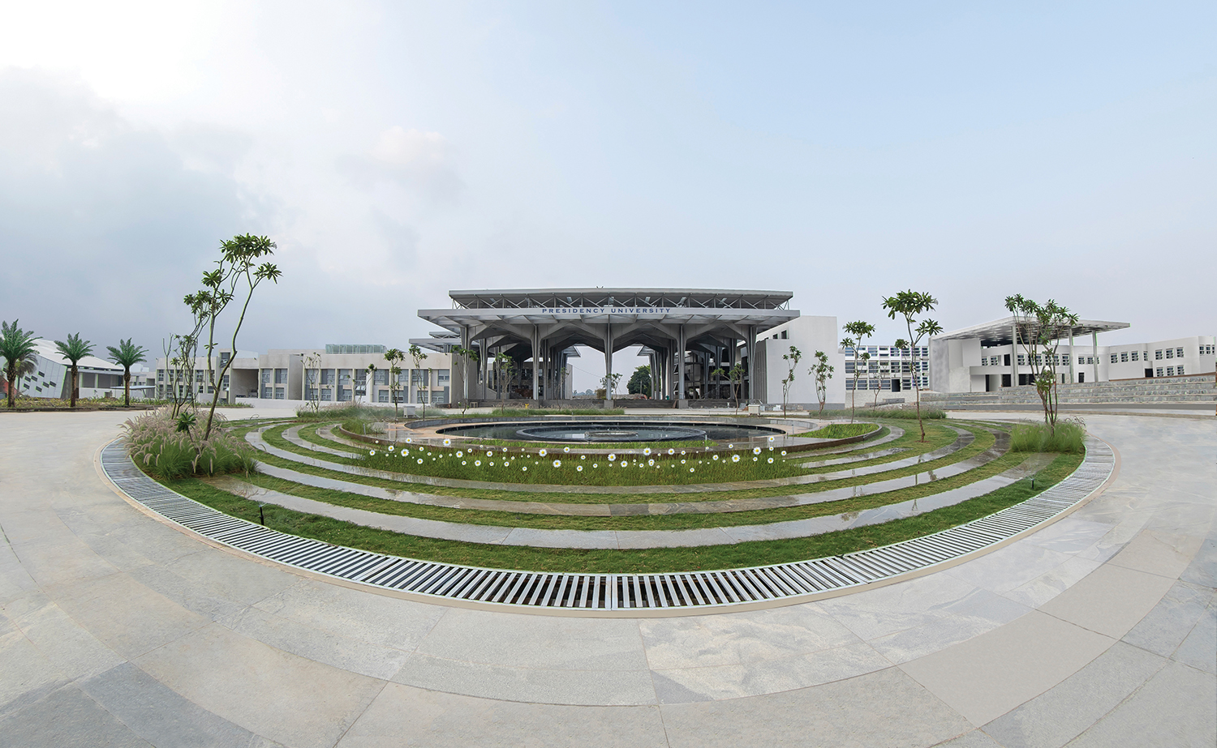

CSE2067 - Web Technologies
Department of Computer Science Engineering
School of Engineering

Slide 2
Module III - Syllabus
MODULE III: PHP [L-10hrs.,P- 10hrs.]
PHP: Introduction to server-side Development with PHP, Arrays, and Superglobals Arrays, $GET and $ POST, Super global Arrays, $_SERVER Array, $_Files Array, Reading/Writing Files, PHP Classes and Objects, Object, Classes and Objects in PHP, Object Oriented Design, Working with Databases, SQL, Database APIs, Managing a MySQL Database. Accessing MySQL in PHP

Slide 3
PHP Introduction
PHP is a acronym for “PHP: Hypertext Preprocessor”
PHP is a server-side scripting language and executed on the server
PHP supports many databases (MySQL, Informix, Oracle, Sybase, Solid, PostgreSQL, Generic ODBC, etc.)‏
PHP is open source software and free to download.
PHP was created by Rasmus Lerdorf in 1994 but appeared in the market in 1995.

Slide 4
PHP Introduction
PHP runs on different platforms (Windows, Linux, Unix, etc.)‏
PHP is compatible with almost all servers used today (Apache, IIS, etc.)‏
PHP is FREE to download from the official PHP resource: www.php.net
PHP is easy to learn and runs efficiently on the server side

Slide 5
PHP Introduction
Some info on MySQL which we will cover in the next...
> MySQL is a database server
> MySQL is ideal for both small and large applications
> MySQL supports standard SQL
> MySQL compiles on a number of platforms
> MySQL is free to download and use

Slide 6
Why use PHP
PHP is a server-side scripting language, which is used to design the dynamic web applications with MySQL database.
PHP supports several protocols such as HTTP, POP3, SNMP, LDAP, IMAP, and many more.
Using PHP language, you can control the user to access some pages of your website.
PHP can handle the forms, such as - collect the data from users using forms, save it into the database, and return useful information to the user. For example - Registration form

Slide 7
What Can PHP Do?
PHP can generate dynamic page content
PHP can create, open, read, write, delete, and close files on the server
PHP can collect data through forms
PHP can send and receive cookies
PHP can add, delete, modify data in your database
PHP can be used to control user-access
PHP can encrypt data

Slide 8
PHP Syntax
Basic PHP Syntax
PHP pages contain HTML with embedded code that does "something”.
A PHP script can be placed anywhere in the document.
A PHP script starts with <?php and ends with ?>
<?php // Start
// PHP code goes here
?> //End

Slide 9
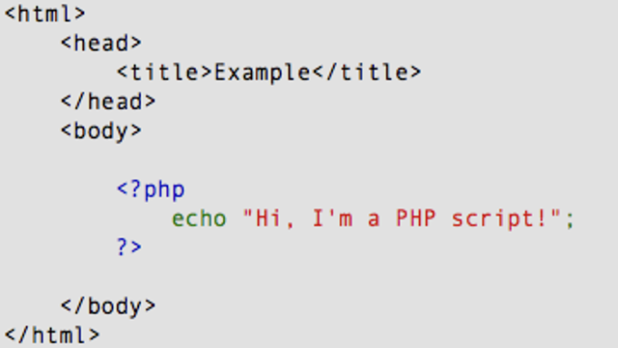
PHP Introduction

Slide 10
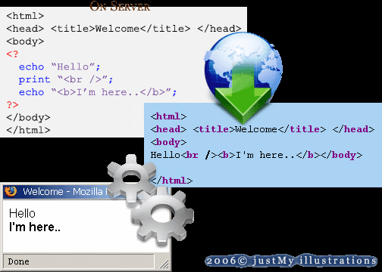
PHP Introduction
PHP code is executed on the server, and the result is returned to the browser as plain HTML

Slide 11
PHP Getting Started
To install PHP, we will suggest you to install AMP (Apache, MySQL, PHP) software stack. There are many AMP options available in the market that are given below:
WAMP for Windows
LAMP for Linux
MAMP for Mac
SAMP for Solaris
XAMPP (Cross, Apache, MySQL, PHP, Perl) for Cross Platform: It includes some other components too such as FileZilla, OpenSSL, Webalizer, Mercury Mail, etc.

Slide 12
PHP Hello World
Executing first PHP script
First Install the Xampp software.
Open XAMPP ControlPanel.
Start Apache and MysQL modules.
Go to Xampp → htdocs
Create the PHP script and save it using .php extension.
Execution: Open the browser and type: localhost/first.php

Slide 13
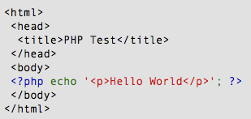
PHP Hello World
// PHP files have extension ".php“ (first.php)
// Write the following code inside a notepad file and save it in htdocs folder

Slide 14
PHP echo and print Statements
echo and print are more or less the same.
The differences are small: echo has no return value while print has a return value of 1 so it can be used in expressions.
echo can take multiple parameters (although such usage is rare) while print can take one argument.
echo is marginally faster than print.

Slide 15
PHP echo and print Statements
Echo
<?php
$name="John";
echo $name;
//or
echo ($name);
?>
Print
<?php
$name="John";
print $name;
//or
print ($name);
?>

Slide 16
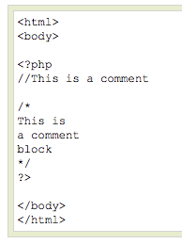
PHP Comments
In PHP, we use // or # to make a single-line comment or /* and */ to make a large comment block.

Slide 17

PHP Variables
Variables are used for storing values, like text strings, numbers or arrays.
All variables in PHP start with a $ sign symbol.
The correct way of declaring a variable in PHP:

Slide 18

PHP Variables
In PHP, a variable does not need to be declared before adding a value to it.
you do not have to tell PHP which data type the variable is.
PHP automatically converts the variable to the correct data type, depending on its value.

Slide 19
PHP Variables
RULES
A variable name must start with a letter or an underscore "_“ not a number
A variable name can only contain alpha-numeric characters, underscores (a-z, A-Z, 0-9, and _ )‏
A variable name should not contain spaces. If a variable name is more than one word, it should be separated with an underscore ($my_string) or with capitalization ($myString)‏

Slide 20
PHP Variables
// Defining new variables and printing their values
<html>
<body>
<?php
$txt = "Hello world!"; // defining variable
$x = 5;
$y = 10.5;
echo $txt;
echo "<br>";
echo $x;
echo "<br>";
echo $y;
?>
</body>
</html>
Hello world! 5 10.5

Slide 21
PHP Variables
PHP variables: local and global
<html>
<body>
<? php
$x = 5; // global scope
function Test() {
// using x inside this function will generate an error
echo "<p>Variable x inside function is: $x</p>";
}
Test();
echo "<p>Variable x outside function is: $x</p>";
?>
</body>
</html>
Notice: Undefined variable: x in C:\xampp\htdocs\first.php on line 9 Variable x inside function is:
Variable x outside function is: 5

Slide 22
PHP Variables
PHP variables: local and global
<html>
<body>
<? php
$x=10;
function Test() {
$x=5;
echo "<p>Variable x inside function is: $x</p>";
}
Test();
echo "<p>Variable x outside function is: $x</p>";
?>
</body>
</html>
print('Variable x inside function is:'.$x);
Variable x inside function is: 5
Variable x outside function is: 10

Slide 23
PHP Variables
PHP variables: local and global
<html>
<body>
<? php
$x=5;
$y=6;
function Test() {
global $x,$y; //Access global variable
$x=$y+$x;
}
Test();
echo "<p>Sum of Number: $x</p>";
?>
</body>
</html>
Sum of 2 numbers: 11

Slide 24
PHP Variables
PHP variables: static
Normally, when a function is completed/executed, all of its variables are deleted. However, sometimes we want a local variable NOT to be deleted. We need it for a further job.
<?php
function myTest() {
static $x = 0;
echo $x;
$x++;
}
myTest();
myTest();
myTest();
?>
0 1 2

Slide 25
PHP Concatenation
The concatenation operator (.) is used to put two string values together.
To concatenate two string variables together, use the concatenation operator:
<?php
$x = "good";
$y= "morning";
echo $x." ".$y;
?>
good morning

Slide 26
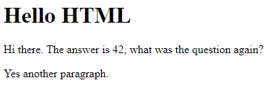
PHP – Html code
<body>
<h1>Hello HTML</h1>
<p>
<?php
echo "Hi there.";
$answer = 6 * 7;
echo "The answer is $answer, what ";
echo "was the question again?";
?>
</p>
<p>Yes another paragraph.</p>
</body>

Slide 27
PHP Data Types
Variables can store data of different types, and different data types can do different things.
PHP supports the following data types:
String
Integer
Float (floating point numbers - also called double)
Boolean
Array
Object
NULL
Resource

Slide 28
PHP String
A string is a sequence of characters, like "Hello world!".
A string can be any text inside quotes.
To use single or double quotes
Example
<?php $x = "Hello world!"; $y = 'Hello world!'; echo $x; echo "<br>"; echo $y; ?>

Slide 29
PHP Integer
An integer data type is a non-decimal number between -2,147,483,648 and 2,147,483,647.
In the following example $x is an integer.
The PHP var_dump() function returns the data type and value
<?php $x = 5985; var_dump($x); ?>
int(5985)

Slide 30
PHP float
A float (floating point number) is a number with a decimal point or a number in exponential form.
Example
<?php $x = 10.365; var_dump($x); ?>
Boolean
A Boolean represents two possible states: TRUE or FALSE.
$x = true; $y = false;

Slide 31
PHP Array
An array stores multiple values in one single variable.
Example
<?php $cars = array("Volvo","BMW","Toyota"); var_dump($cars); ?>
array(3) { [0]=> string(5) "Volvo" [1]=> string(3) "BMW" [2]=> string(6) "Toyota" }
NULL Value
Null is a special data type which can have only one value: NULL.
A variable of data type NULL is a variable that has no value assigned to it. Example
<?php $x = "Hello world!"; $x = null;
var_dump($x); ?>

Slide 32
Ro read value from user – readline()
$s = readline(‘enter string’);
$a = (int)readline(‘Enter an integer’);

Slide 33
PHP Operators
Arithmetic Operators
Logical or Relational Operators
Comparison Operators
Conditional or Ternary Operators
Assignment Operators
Array Operators
Increment/Decrement Operators
String Operators

Slide 34
PHP Operators
1.Arithmetic Operator + = Addition - = Subtraction * = Multiplication / = Division % = Modulo ** = Exponentiation
3.Array Operator + = Union == = Equality === = Identity != = Inequality <> = Inequality !== = Non-identity
2.Assignment Operator = equal to
4.Bitwise Operator & = and ^ = xor | = not << = shift left >> = shift right

Slide 35
PHP Operators
5.Comparison Operator == = equal === = identical != = not equal !== = not identical <> = not equal < = less than <= =less than or equal > = greater than >= = greater than or equal <=> = spaceship operator
(-1,0,1)
6.Incrementing/Decrementing Operator ++$a = PreIncrement $a++ = PostIncrement --$a = PreDecrement $a-- = Postdecrement
7.Logical Operator && = And || = Or ! = Not and = And xor = Xor or = Or

Slide 36
PHP Operators
8. string Operator . = concatenation operator .= =concatenating assignment operator
$txt1 = "Hello";
$txt2 = " world!";
$txt1 .= $txt2;
echo $txt1;
9. Ternary or Conditional operator ?: = Ternary operator
<?php $a = 10; $b = $a > 15 ? 20 : 5; print ("Value of b is " . $b); ?>
Value of b is 5

Slide 37
PHP Conditional statements
PHP if else statement is used to test condition.
if
if-else
if-else-if
nested if

Slide 38
PHP Conditional statements
PHP If Statement
<?php
$num=12;
if($num<100){
echo "$num is less than 100";
}
?>
12 is less than 100

Slide 39
PHP Conditional statements
PHP If else Statement
<?php
$num=12;
if($num%2==0){
echo "$num is even number";
}
else{
echo "$num is odd number";
}
?>
12 is even number

Slide 40
PHP Conditional statements
PHP If-else-if Statement
<?php
$marks=69;
if ($marks<33){
echo "fail";
}
else if ($marks>=34 && $marks<50) { echo "D grade";
}
else if ($marks>=50 && $marks<65) { echo "C grade";
}
else if ($marks>=65 && $marks<80) { echo "B grade";
}
else if ($marks>=80 && $marks<90) {
echo "A grade";
}
else if ($marks>=90 && $marks<100) { echo "A+ grade";
}
else {
echo "Invalid input";
}
?>
B Grade

Slide 41
PHP Conditional statements
PHP Switch Statement
<?php
$favcolor = "red";
switch ($favcolor) {
case "red": echo "Your favourite color is red!"; break;
case "blue": echo "Your favourite color is blue!"; break;
default: echo “Wrong Choice ";
}
?>

Slide 42
PHP Loop
In PHP, we have the following loop types:
while - loops through a block of code as long as the specified condition is true
do...while - loops through a block of code once, and then repeats the loop as long as the specified condition is true
for - loops through a block of code a specified number of times
foreach - loops through a block of code for each element in an array

Slide 43
PHP Loop
PHP while Loop
<?php
$x = 1;
while($x <= 5)
{
echo "The number is: $x <br>";
$x++;
}
?>
PHP do..while Loop
<?php
$x = 1;
do {
echo "The number is: $x <br>";
$x++;
} while ($x <= 5);
?>

Slide 44
PHP Loop
PHP for Loop
<?php
for ($x = 0; $x <= 10; $x++) {
echo "The number is: $x <br>";
}
?>
PHP foreach Loop
<?php
$colors = array("red", "green", "blue", "yellow");
foreach ($colors as $value) {
echo “ $value <br>";
}
?>
red green blue yellow

Slide 45
PHP Loop
PHP for Loop
<?php
for ($x = 0; $x <= 10; $x++) {
echo "The number is: $x <br>";
}
?>
PHP foreach Loop
<?php
$colors = array("red", "green", "blue", "yellow");
foreach ($colors as $value) {
echo “ $value <br>";
}
?>
red green blue yellow

Slide 46
PHP Functions
PHP function is a piece of code that can be reused many times.
It can take input as argument list and return value
Syntax
function functionname(){
//code to be executed
}
Example
<?php
function sayHello(){
echo "Hello PHP Function";
}
sayHello();//calling function
?>

Slide 47
PHP Function Arguments
pass the information in PHP function through arguments which is separated by comma.
PHP supports :
Call by Value (default),
Call by Reference
Default argument values

Slide 48
PHP Function Arguments
PHP Call By Value
<?php
function sayHello($name,$age){
echo "Hello $name, you are $age years old <br/>";
}
sayHello("Sai",27);
sayHello("Vimal",29);
sayHello("John",23);
?>
Hello Sai, you are 27 years old
Hello Vimal, you are 29 years old
Hello John, you are 23 years old

Slide 49
PHP Function Arguments
PHP Call By Reference
To pass value as a reference, you need to use ampersand (&) symbol before the argument name.
<?php
function adder(&$str2)
{
$str2 .= 'Call By Reference';
}
$str = 'Hello ';
adder($str);
echo $str;
?>
Hello Call By Reference

Slide 50
PHP Function Arguments
PHP Default Argument Value
don't specify any argument, it will take the default argument.
<?php
function sayHello($name="SAI"){
echo "Hello $name<br/>";
}
sayHello("Rajesh");
sayHello();//passing no value
sayHello("John");
?>
Hello Rajesh
Hello SAI
Hello John

Slide 51
PHP Function Arguments
PHP Returning Value
PHP function that returns value.
<?php
function cube($n){
return $n*$n*$n;
}
echo "Cube of 3 is: ".cube(3);
?>
Cube of 3 is: 27

Slide 52
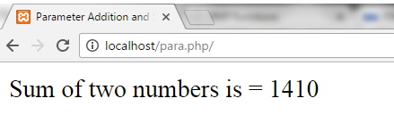
PHP Function Arguments
PHP Parameterized Example 1
<html>
<head> <title>Parameter Addition and Subtraction Example</title> </head>
<body>
<?php
function add($x, $y) { //Adding two numbers
$sum = $x + $y;
echo "Sum of two numbers is = $sum <br><br>";
}
add(467, 943);
?>
</body>
</html>

Slide 53
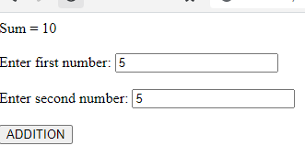
PHP Function Arguments
PHP Parameterized Example 2 – using forms
<?php
function add($x,$y) {
$sum=$x+$y;
echo "Sum = $sum <br><br>";
}
if(isset($_POST[‘submit'])) {
add($_POST['first'],$_POST['second']);
}
?>
<form method="post">
Enter first number: <input type="number" name="first"/><br><br>
Enter second number: <input type="number" name="second"/><br><br>
<input type="submit" name=“submit" value="ADDITION"/>
</form>

Slide 54
PHP Array
An array stores multiple values in one single variable:
Example
<?php
$cars = array("Volvo", "BMW", "Toyota");
echo "I like " . $cars[0] . ", " . $cars[1] . " and " . $cars[2] . ".";
?>

Slide 55
PHP Array
Create an Array in PHP
array(); - function is used to create an array
In PHP, there are three types of arrays:
Indexed arrays - Arrays with a numeric index
Associative arrays - Arrays with named keys
Multidimensional arrays - Arrays containing one or more arrays

Slide 56
PHP Array
Get The Length of an Array - The count() Function
The count() function is used to return the length (the number of elements) of an array
Example
<?php
$cars = array("Volvo", "BMW", "Toyota");
echo count($cars); // 3
?>

Slide 57
PHP Array
PHP Indexed Arrays
Here are two ways to create indexed arrays:
The index can be assigned automatically .
$cars = array("Volvo", "BMW", "Toyota");
The index can be assigned manually:
$cars[0] = "Volvo"; $cars[1] = "BMW"; $cars[2] = "Toyota";

Slide 58
PHP Array
Loop Through an Indexed Array
Example
<?php $cars= array("Volvo", "BMW", "Toyota"); $arrlength = count($cars); for($x = 0; $x < $arrlength; $x++) { echo $cars[$x]; echo "<br>"; } ?>
Volvo BMW Toyota

Slide 59
PHP Array
PHP Associative Arrays
Associative arrays are arrays that use named keys that you assign to them.
There are two ways to create an associative array:
$age = array("Peter"=>"35", "Ben"=>"37", "Joe"=>"43");
or
$age['Peter'] = "35"; $age['Ben'] = "37"; $age['Joe'] = "43";

Slide 60
PHP Array
Loop Through an Associative Array
Example
<?php $age = array("Peter"=>"35", "Ben"=>"37", "Joe"=>"43");
foreach($age as $x => $x_value)
{
echo "Key=" . $x . ", Value=" . $x_value;
echo "<br>"; } ?>
Key=Peter, Value=35 Key=Ben, Value=37 Key=Joe, Value=43

Slide 61
PHP Array
PHP - Multidimensional Arrays
A multidimensional array is an array containing one or more arrays

Slide 62
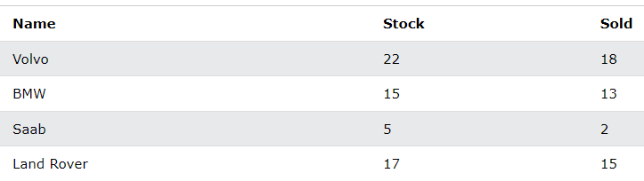
PHP Array
Two-dimensional Arrays
A two-dimensional array is an array of arrays
$cars = array ( array("Volvo",22,18), array("BMW",15,13), array("Saab",5,2), array("Land Rover",17,15) );

Slide 63
PHP Array
Two-dimensional Arrays
for ($row = 0; $row < 4; $row++)
{
echo "<p><b>Row number $row</b></p>";
echo "<ul>";
for ($col = 0; $col < 3; $col++)
{
echo "<li>".$cars[$row][$col]."</li>";
}
echo "</ul>";
}
?>
Example
<?php
$cars = array (
array("Volvo",22,18),
array("BMW",15,13),
array("Saab",5,2),
array("Land Rover",17,15)
);
Row number 0
Volvo
22
18

Slide 64
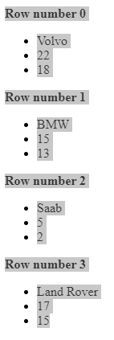

Slide 65
PHP Array
Sorting Arrays
The elements in an array can be sorted in alphabetical or numerical order, descending or ascending.
Sort Functions For Arrays
sort() - sort arrays in ascending order
rsort() - sort arrays in descending order
asort() - sort associative arrays in ascending order, according to the value
ksort() - sort associative arrays in ascending order, according to the key
arsort() - sort associative arrays in descending order, according to the value
krsort() - sort associative arrays in descending order, according to the key

Slide 66
PHP Array
Sorting Arrays
The following example sorts the elements of the $cars array in ascending alphabetical order:
Example
<?php
$cars=array("Volvo","BMW","Toyota");
$arrlength = count($cars);
sort($cars);
for($x =0; $x < $arrlength; $x++)
{
echo $cars[$x];
echo "<br>";
}
?>
BMW Toyota Volvo

Slide 67
PHP Superglobals:
Super global variables are built-in variables that are always available in all scopes
Some predefined variables in PHP are "superglobals", which means that they are always accessible, regardless of scope - and you can access them from any function, class or file without having to do anything special.
The PHP superglobal variables are:
$GLOBALS
$_SERVER
$_REQUEST
$_POST
$_GET
$_FILES

Slide 68
PHP $GLOBALS
$GLOBALS is an associative array of references to all globally defined variables. Names of variables form keys and their contents are values of associative array.
Example #1 $GLOBALS example
<?php $x = 75; $y = 25; function addition() { $GLOBALS['z'] = $GLOBALS['x'] + $GLOBALS['y']; } addition(); echo $z; ?>

Slide 69
PHP $_SERVER
$_SERVER is a PHP super global variable which holds information about headers, paths, and script locations.
Example
<?php echo $_SERVER['PHP_SELF’];/*Returns the filename of the currently executing script echo "<br>"; echo $_SERVER['SERVER_NAME’];/*Returns the name of the host server (such as www.w3schools.com) echo "<br>"; echo $_SERVER['HTTP_HOST’]; /*Host header from the current request echo "<br>"; echo $_SERVER['HTTP_REFERER']; echo "<br>"; complete URL of the
current page echo $_SERVER['HTTP_USER_AGENT']; echo "<br>"; echo $_SERVER['SCRIPT_NAME']; ?>the path of the current script

Slide 70
PHP $_GET
The GET method is used to submit the HTML form data. This data is collected by the predefined $_GET variable for processing.
The information sent from an HTML form using the GET method is visible to everyone in the browser's address bar, which means that all the variable names and their values will be displayed in the URL.
localhost/gettest.php?username=Harry&bloodgroup=AB+

Slide 71
PHP $_GET
The below code will display an HTML form containing two input fields and a submit button. In this HTML form, we used the method = "get" to submit the form data.
<form action="welcome.php" method=“get"> Name: <input type="text" name="name"><br> E-mail: <input type="text" name="email"><br> <input type="submit"> </form>
<?php
echo $_GET["name"]; echo $_GET["email"];
?>

Slide 72
PHP $_POST
PHP $_POST is a PHP super global variable which is used to collect form data after submitting an HTML form with method="post". $_POST is also widely used to pass variables.
<form action="welcome.php" method="post"> Name: <input type="text" name="name"><br> E-mail: <input type="text" name="email"><br> <input type="submit"> </form>
<?php
echo $_POST["name"]; echo $_POST["email"];
?>

Slide 73
$_FILES – Superglobal Variable
$_FILES superglobal variable used when we upload files using Form elements. All the necessary information including File temporary name, File size, File Type are available in this $_FILES variable.
Example
<form method="POST" action="action.php" enctype="multipart/form-data">
<input type="text" name="name"/>
<input type="file" name="file" id="file" />
<input type="submit" value="Send"/>
</form>
<?php
echo "<pre>";
print_r($_FILES); echo "</pre>"; //prints uploaded File's information
echo $_POST['name'];
?>

Slide 74
PHP File Handling
File handling is an important part of any web application. You often need to open and process a file for different tasks.
Manipulating Files
PHP has several functions for creating, reading, uploading, and editing files.
readfile() Function
The readfile() function reads a file and writes it to the output buffer.

Slide 75

PHP File Handling
<?php
echo readfile("Hai.txt");
?>

Slide 76
PHP File Handling
Open File - fopen()
A better method to open files is with the fopen() function.
This function gives you more options than the readfile() function.
$myfile = fopen(“Hai.txt", "r") or die("Unable to open file!");
Read File - fread()
The fread() function reads from an open file.
fread($myfile,filesize("webdictionary.txt"));
Close File - fclose()
The fclose() function is used to close an open file.
fclose($myfile);

Slide 77


PHP File Handling
<!DOCTYPE html>
<html>
<body>
<?php
$myfile = fopen(“Hai.txt", "r") or die("Unable to open file!");
echo fread($myfile,filesize(“Hai.txt"));
fclose($myfile);
?>
</body>
</html>

Slide 78
The file may be opened in one of the following modes:
Modes | Description
r | Open a file for read only. File pointer starts at the beginning of the file
w | Open a file for write only. Erases the contents of the file or creates a new file if it doesn't exist. File pointer starts at the beginning of the file
a | Open a file for write only. The existing data in file is preserved. File pointer starts at the end of the file. Creates a new file if the file doesn't exist
x | Creates a new file for write only. Returns FALSE and an error if file already exists
r+ | Open a file for read/write. File pointer starts at the beginning of the file
w+ | Open a file for read/write. Erases the contents of the file or creates a new file if it doesn't exist. File pointer starts at the beginning of the file
a+ | Open a file for read/write. The existing data in file is preserved. File pointer starts at the end of the file. Creates a new file if the file doesn't exist
x+ | Creates a new file for read/write. Returns FALSE and an error if file already exists

Slide 79
PHP Write to File - fwrite()
The fwrite() function is used to write to a file.
The first parameter of fwrite() contains the name of the file to write to and the second parameter is the string to be written.
<?php
$myfile = fopen("Haii.txt", "w") or die(“Error!");
$txt = "Prabhu\n";
fwrite($myfile, $txt);
$txt = "Shankar\n";
fwrite($myfile, $txt);
fclose($myfile);
?>

Slide 80


